Slide 1


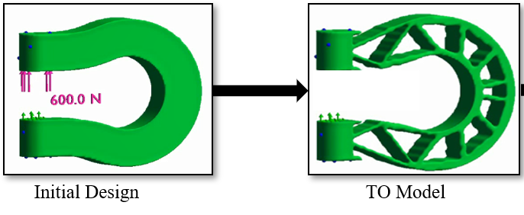
Tutorial 1
Learning Topology Optimization Through Examples and Case Studies
August 18, 2019

Slide 2
Pareto Method of Topology Optimization

Slide 3
Current TO Strategies
TO Strategies
Homogenization
SIMP
Level-Set
Evolutionary

Slide 4
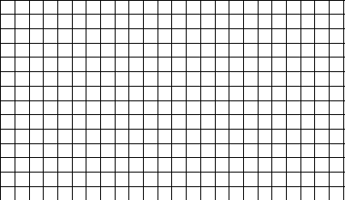

SIMP
SIMP: Solid Isotropic Material with Penalization
- Easy to implement
- Well established
- Poorly conditioned K matrix
Where do we add holes?
- Ill-defined boundary

Slide 5
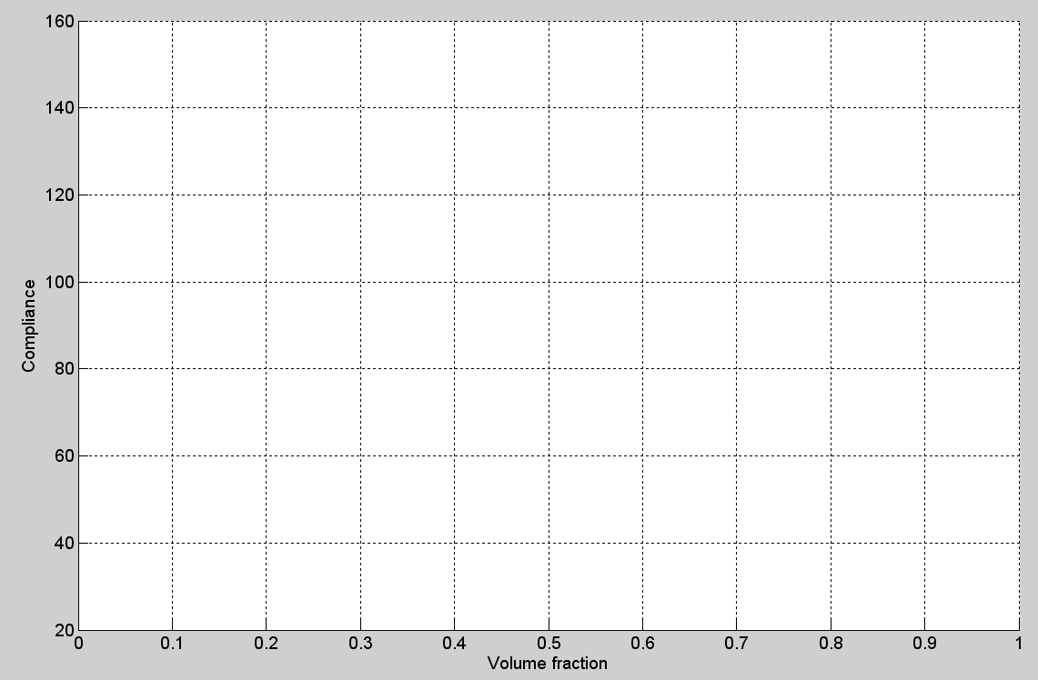
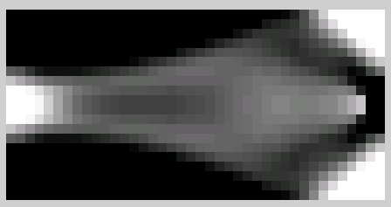
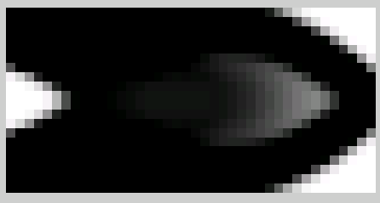
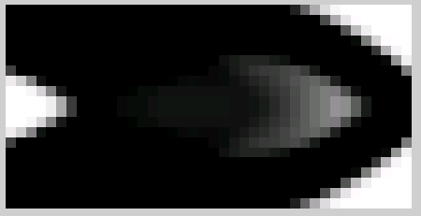
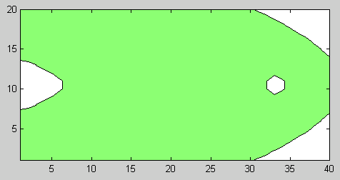
Traditional
Remove 15%
material

Slide 6
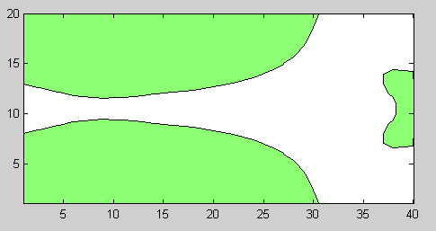
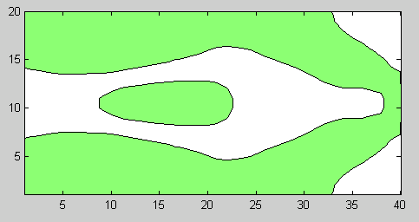
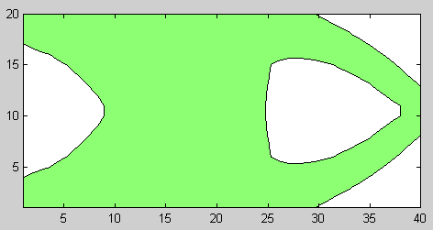
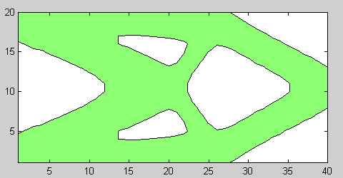
Traditional
Remove 40%
material

Slide 7
Traditional

Slide 8
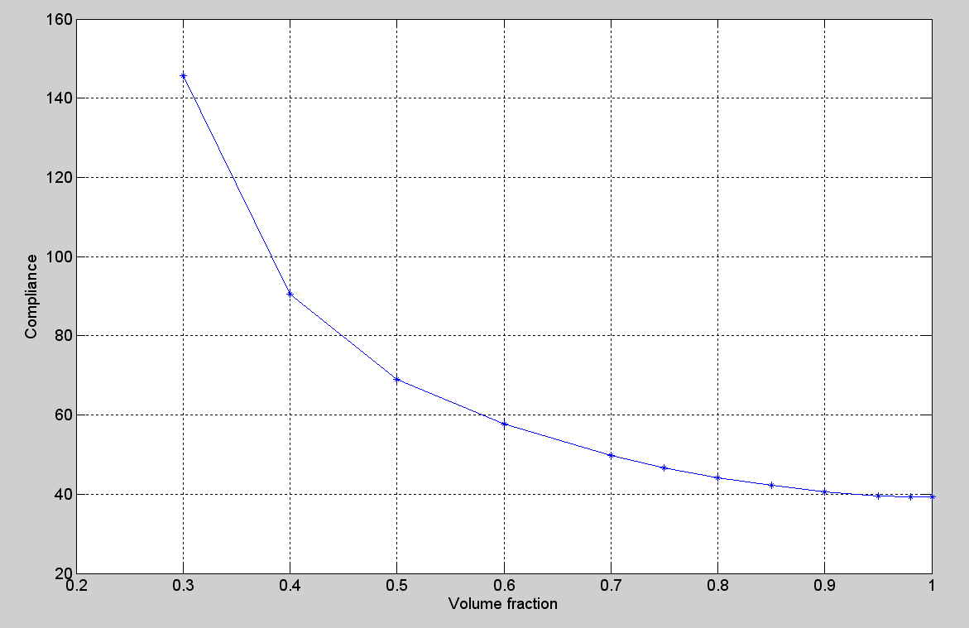
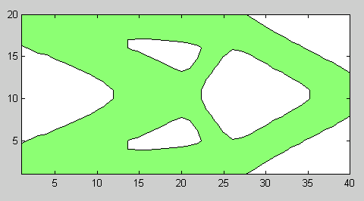
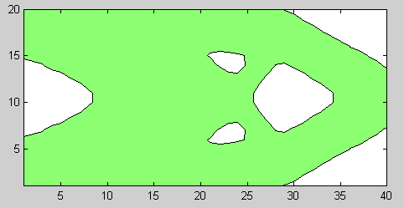
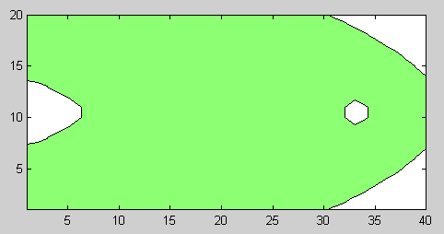
One Design At a Time
Non-optimal
Designs
Can one directly generate
Pareto-optimal topologies?
Pareto optimal
curve
Pareto optimal
topologies

Slide 9
Pareto
A topological sensitivity
based method

Slide 10
Current TO Strategies
TO Strategies
Homogenization
SIMP
Level-Set
Evolutionary
Pareto

Slide 11
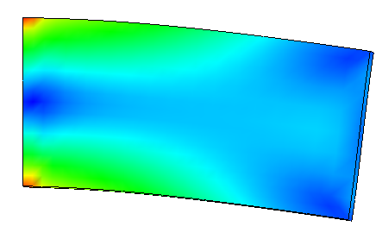
Intuition …
Stress Plot
Remove material, but keep it stiff!
strong!
A
B

Slide 12
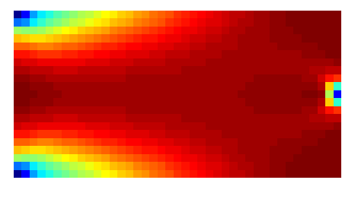

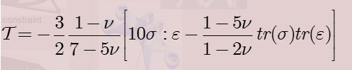
Topological Sensitivity
Compliance (J) change?
B
A
1.36
0.00004
[Novotny 06]

Slide 13
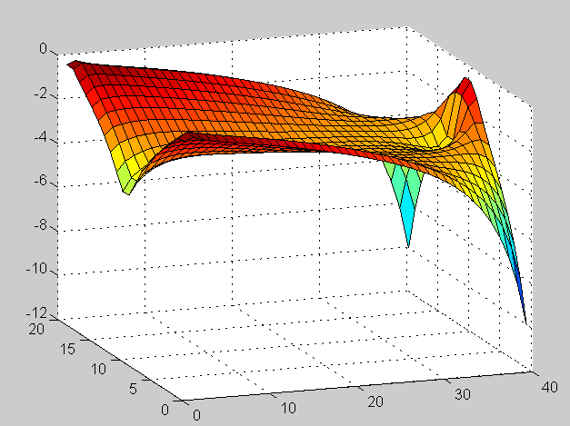
Visualize in 3-D

Slide 14
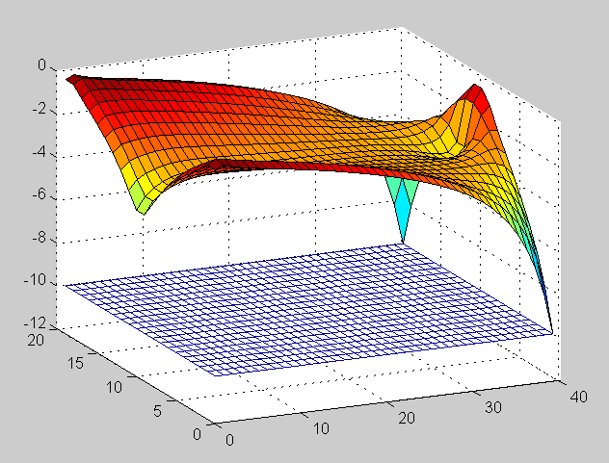

Topological Level-Set

Slide 15
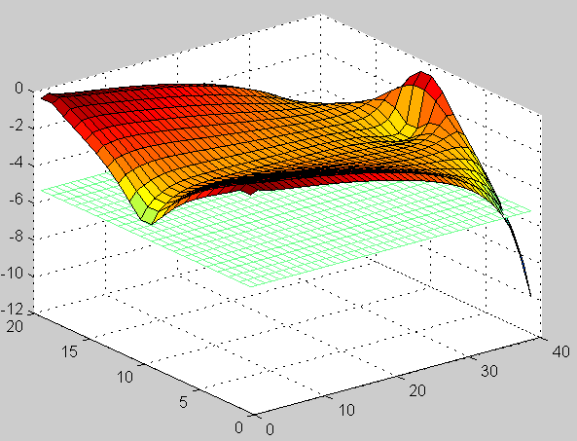
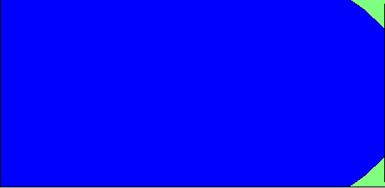
Topological Level-Set

Slide 16
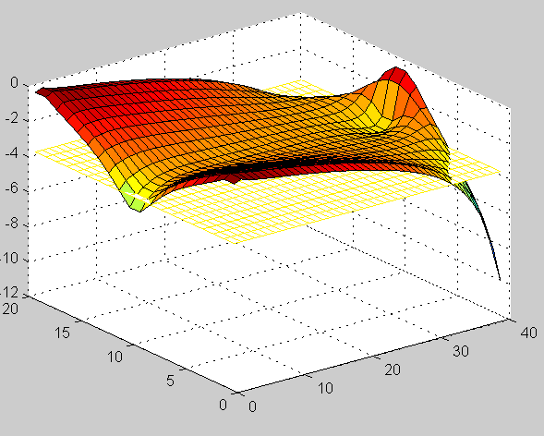
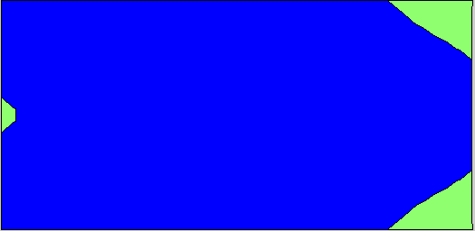
Topological Level-Set

Slide 17
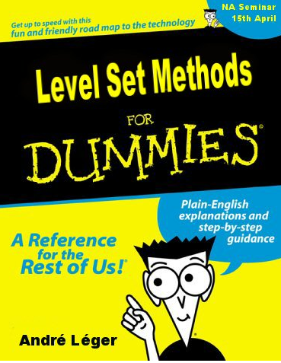
Level Set

Slide 18
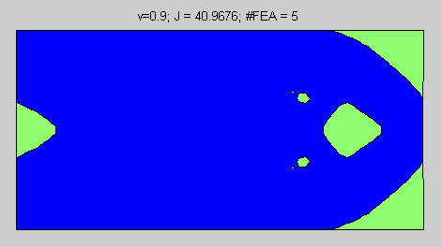
Pareto Algorithm
 | Suresh, K., “199-line Matlab code for Pareto-Optimal Tracing in Topology Optimization,” JSMO. Vol. 42, No. 5, 2010
Pareto-Optimal?
Design
Space
FEA
TopSens
Filtering
Adaptive
…
Recompute τ
No
Decrement
Volume
Yes

Slide 19
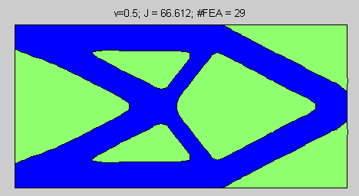
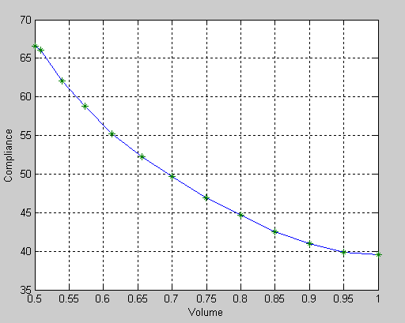
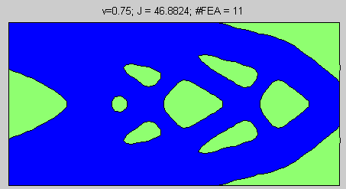
Pareto Optimal Designs
Multiple optimal topologies
Well conditioned K matrix
Well defined boundary

Slide 20
Pareto
MATLAB Demo

Slide 21
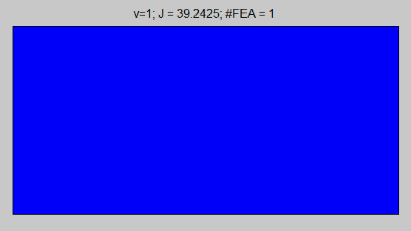
Comparison
SIMP
Pareto
Software: www.ersl.wisc.edu

Slide 22
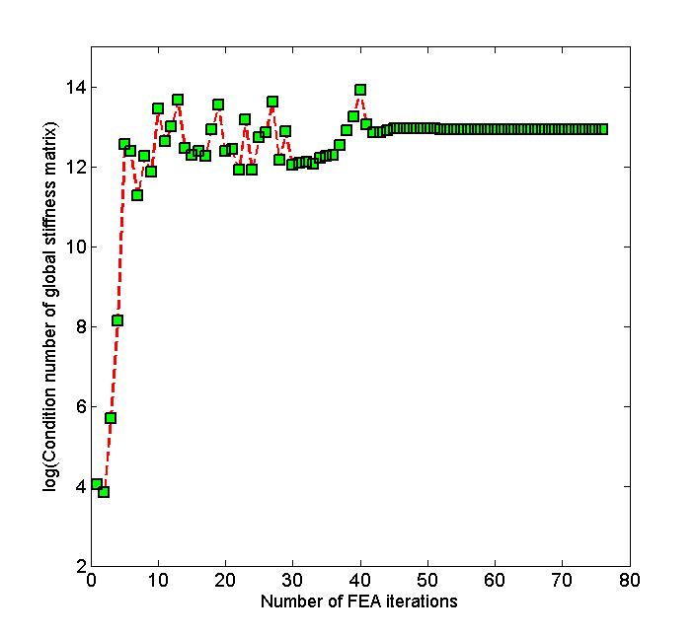
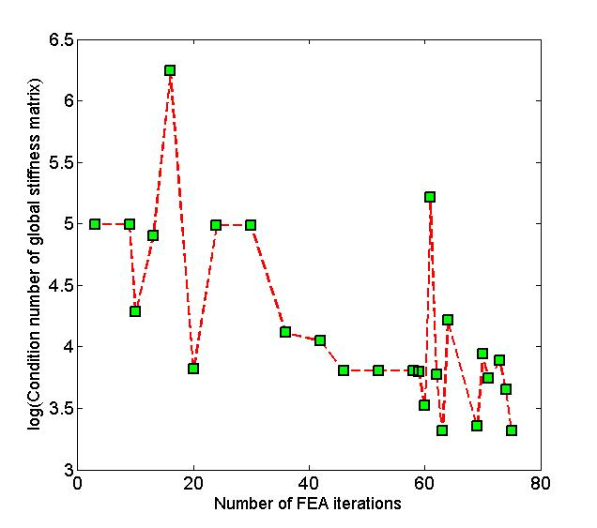
Log(Condition Number of K)
SIMP
Pareto

Slide 23
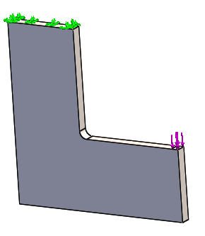
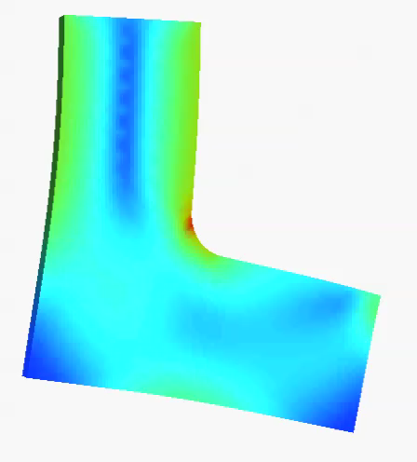
Pareto in 3D

Slide 24
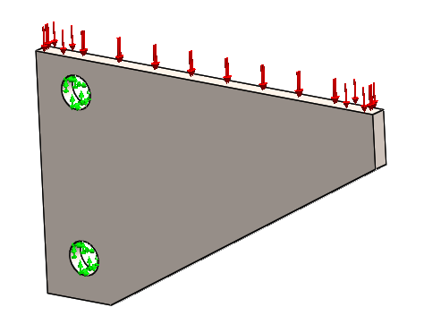
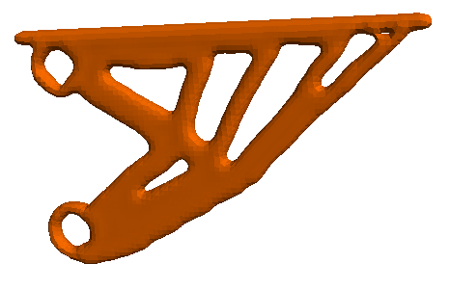
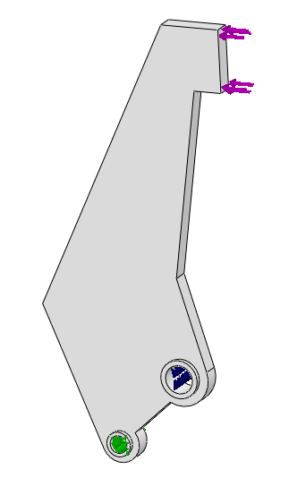
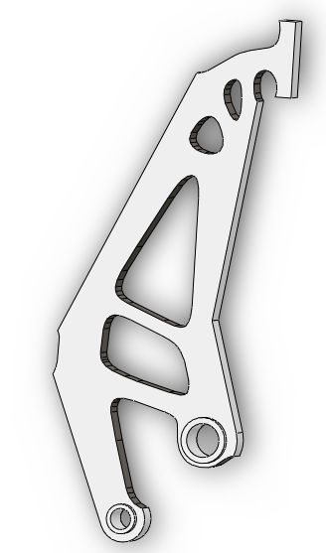
Pareto in 3D

Slide 25
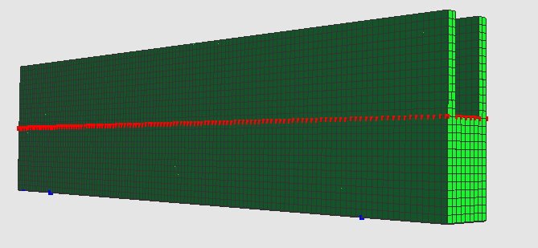
TopOpt Obeys Engineering Principles

Slide 26
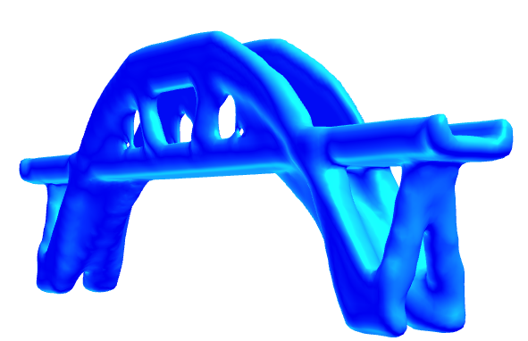
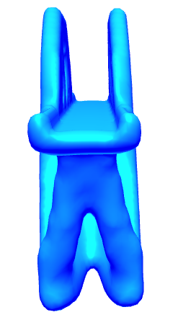
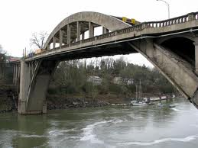
Bridge Design

Slide 27
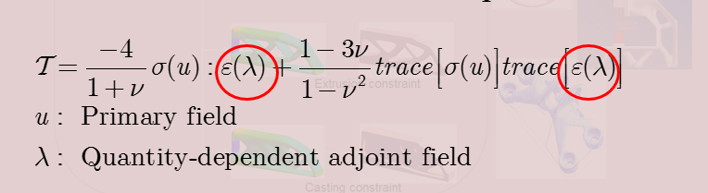

Generalization
Stress Plot
Remove material, but keep it stiff!
strong!

Slide 28
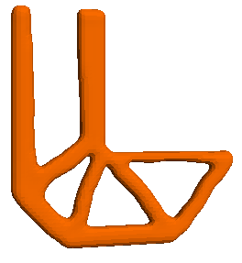
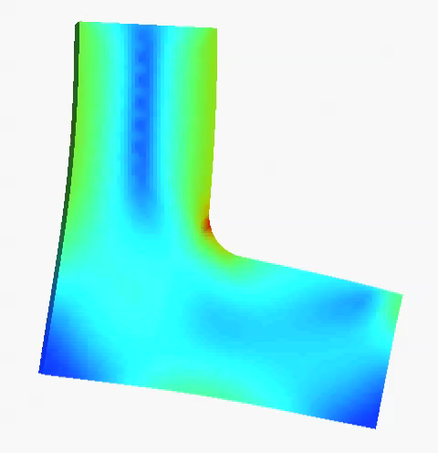
Stiff vs. Strong
Stiff Design
Strong Design
Suresh, K., Takalloozadeh, M., “Stress-constrained topology optimization: a topological level-set approach”, Structural and Multidisciplinary Optimization, Vol. 48, Issue 2, pp. 295-309, 2013

Slide 29
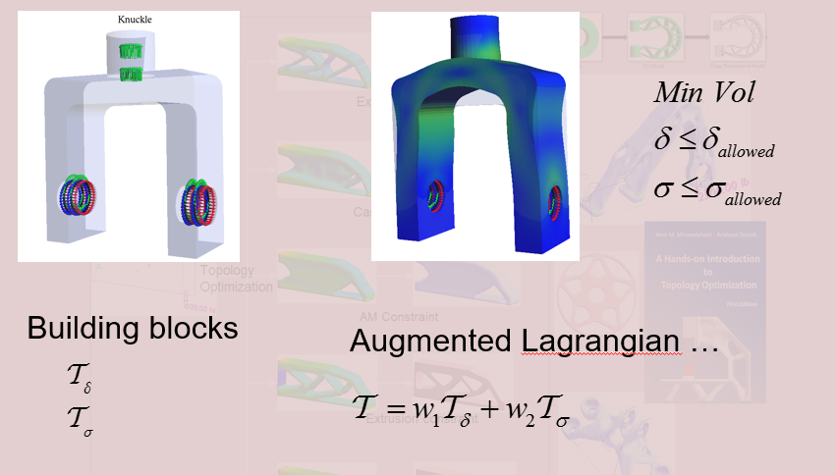
Constraints
Deng, S., Suresh, K., “Multi-Constrained Topology Optimization via the Topological Sensitivity,” Structural and Multidisciplinary Optimization, November, 2014

Slide 30
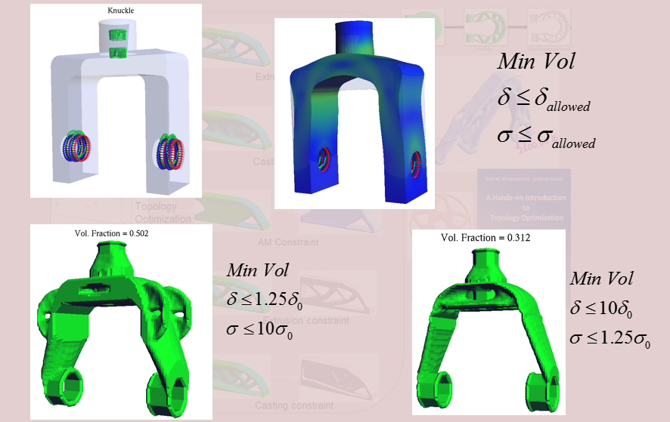
Constraints

Slide 31
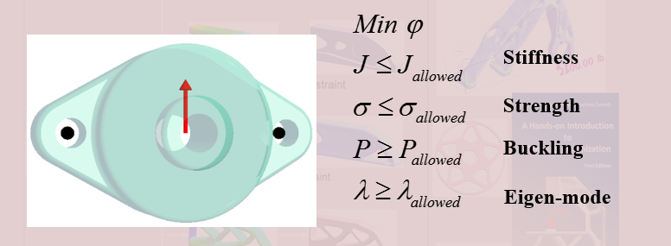
Multi-Constrained TopOpt

Slide 32
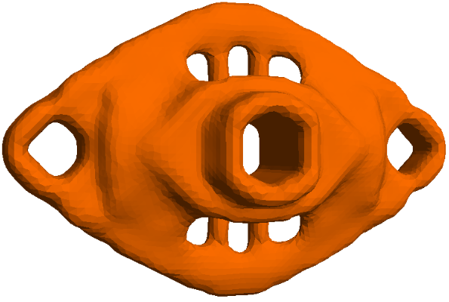
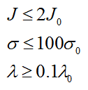




Constrained TO
Compliance
Dominated
Stress
Dominated
Eigen-value
Dominated

